Slide 1

Let’s See How To Add A Normal User and An Admin
By GROUP G (Sandhya Lokesh, Prajna C, Pooja Kadam)

Slide 2
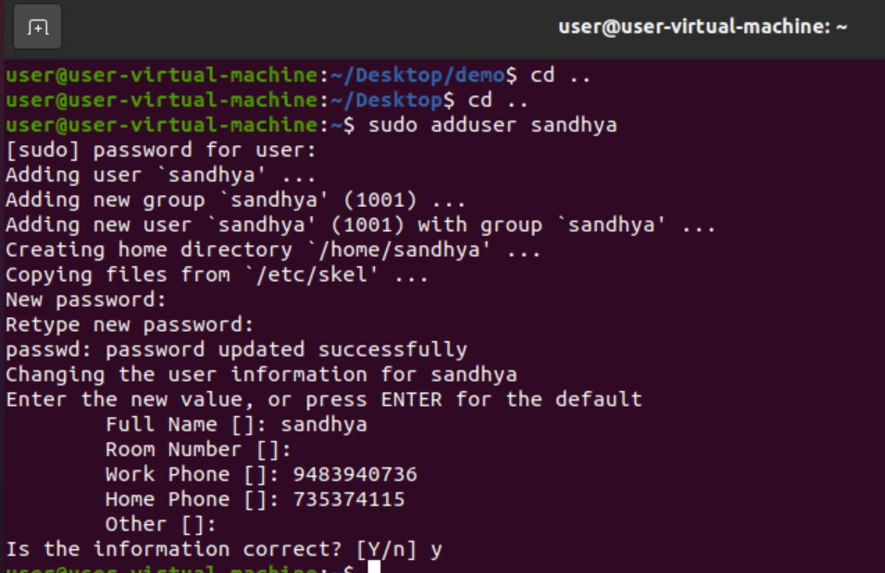
Step 1: To add a normal user
Type sudo adduser ‘username’

Slide 3
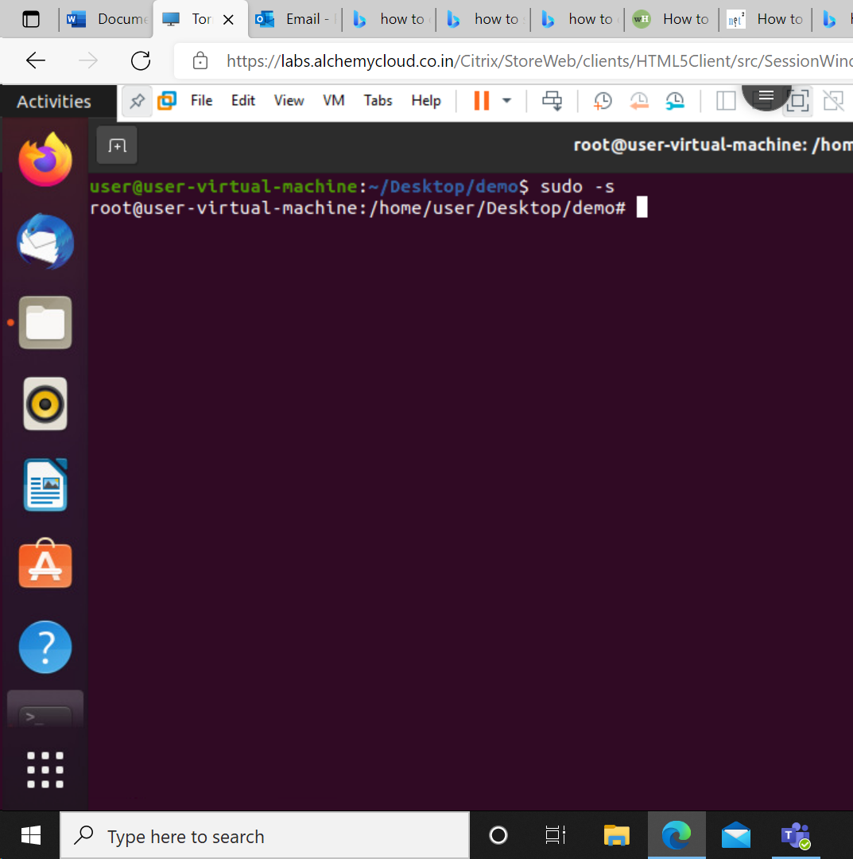
Step 2: To change user to root user
Type sudo –s

Slide 4
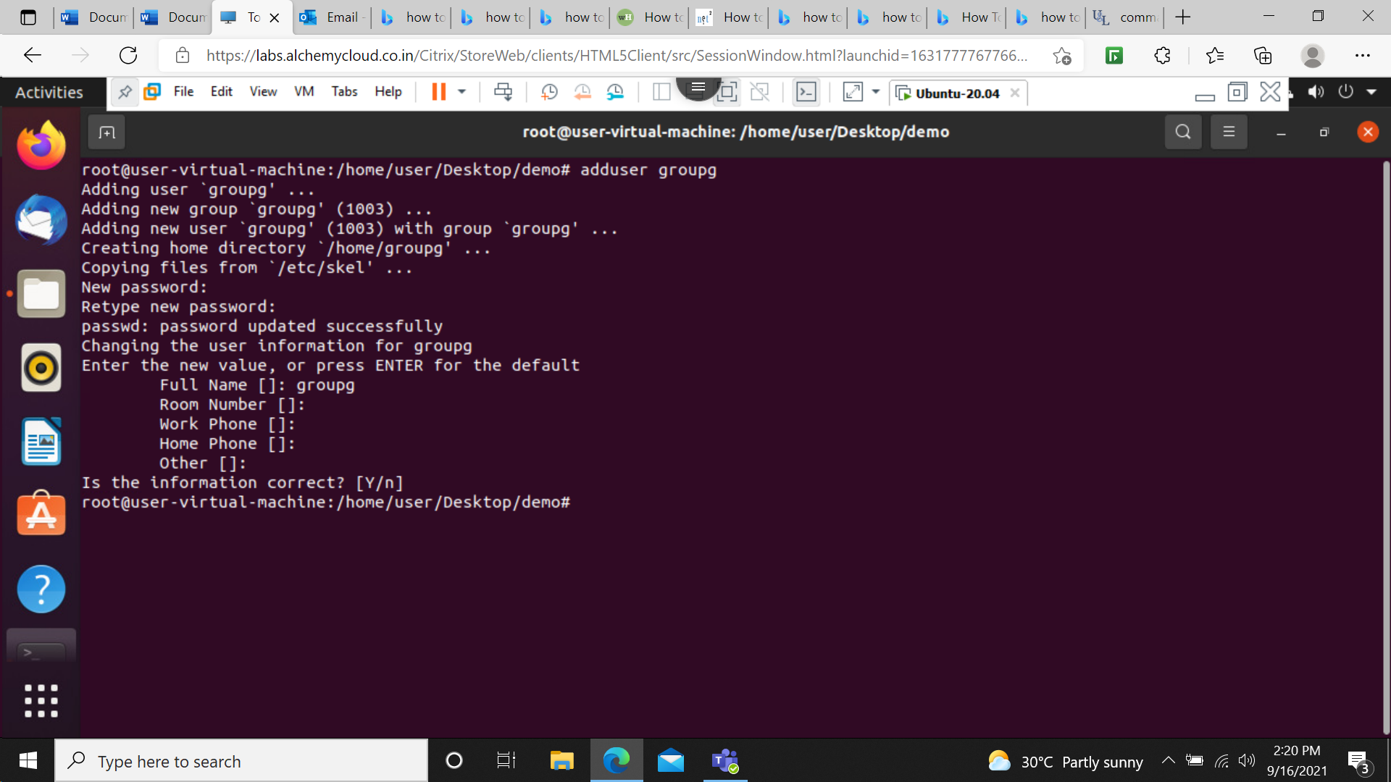
Step 3: Adding user as the root
Type adduser ‘username’
Must start with a lowercase letter.
May only contain lowercase letters, underscore (_), and dash (-)
May optionally end with a dollar sign ($)
ENTER PASSWORD

Slide 5
Asks for confirmation
Hit y

Slide 6
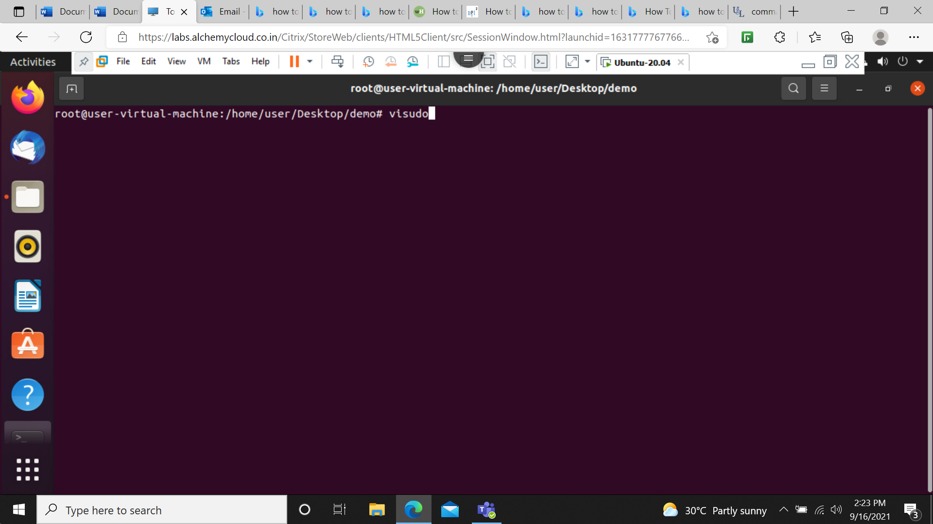
Step 4:Grant user root privileges
Type visudo

Slide 7
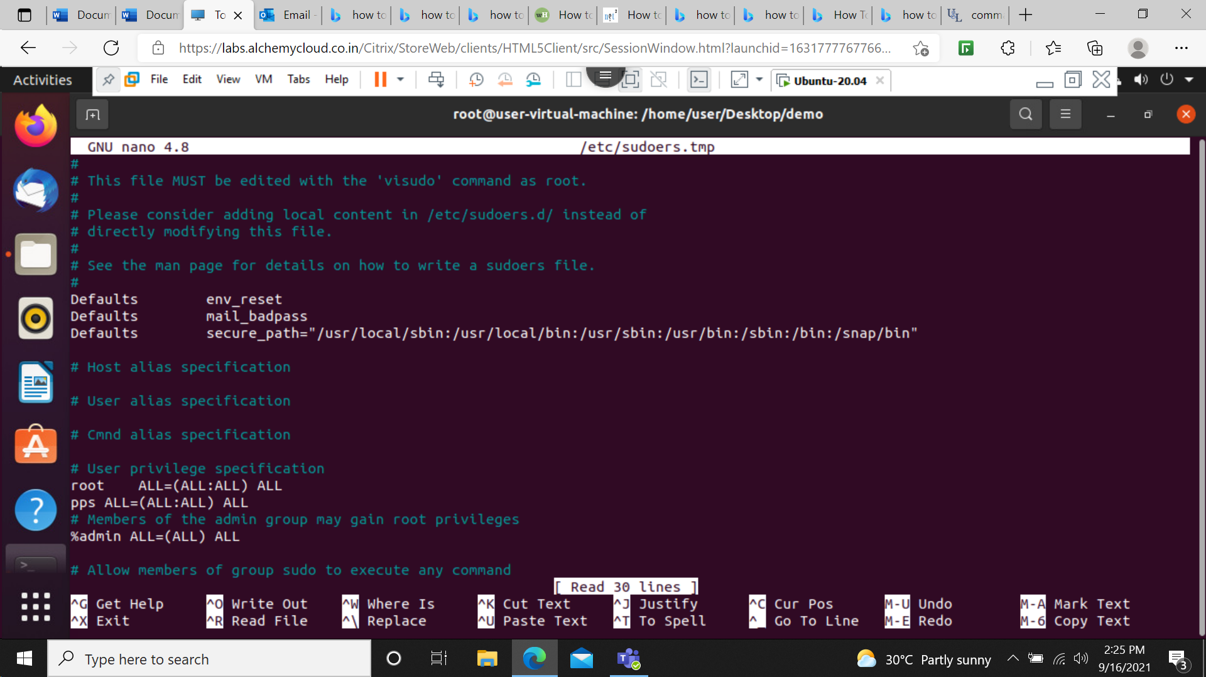
Scroll down and add user in privilege specifications
As groupg ALL-(ALL:ALL) ALL
Then cltr=x to exit from that window
Then system asks for changes hit y
Then hit enter

Slide 8
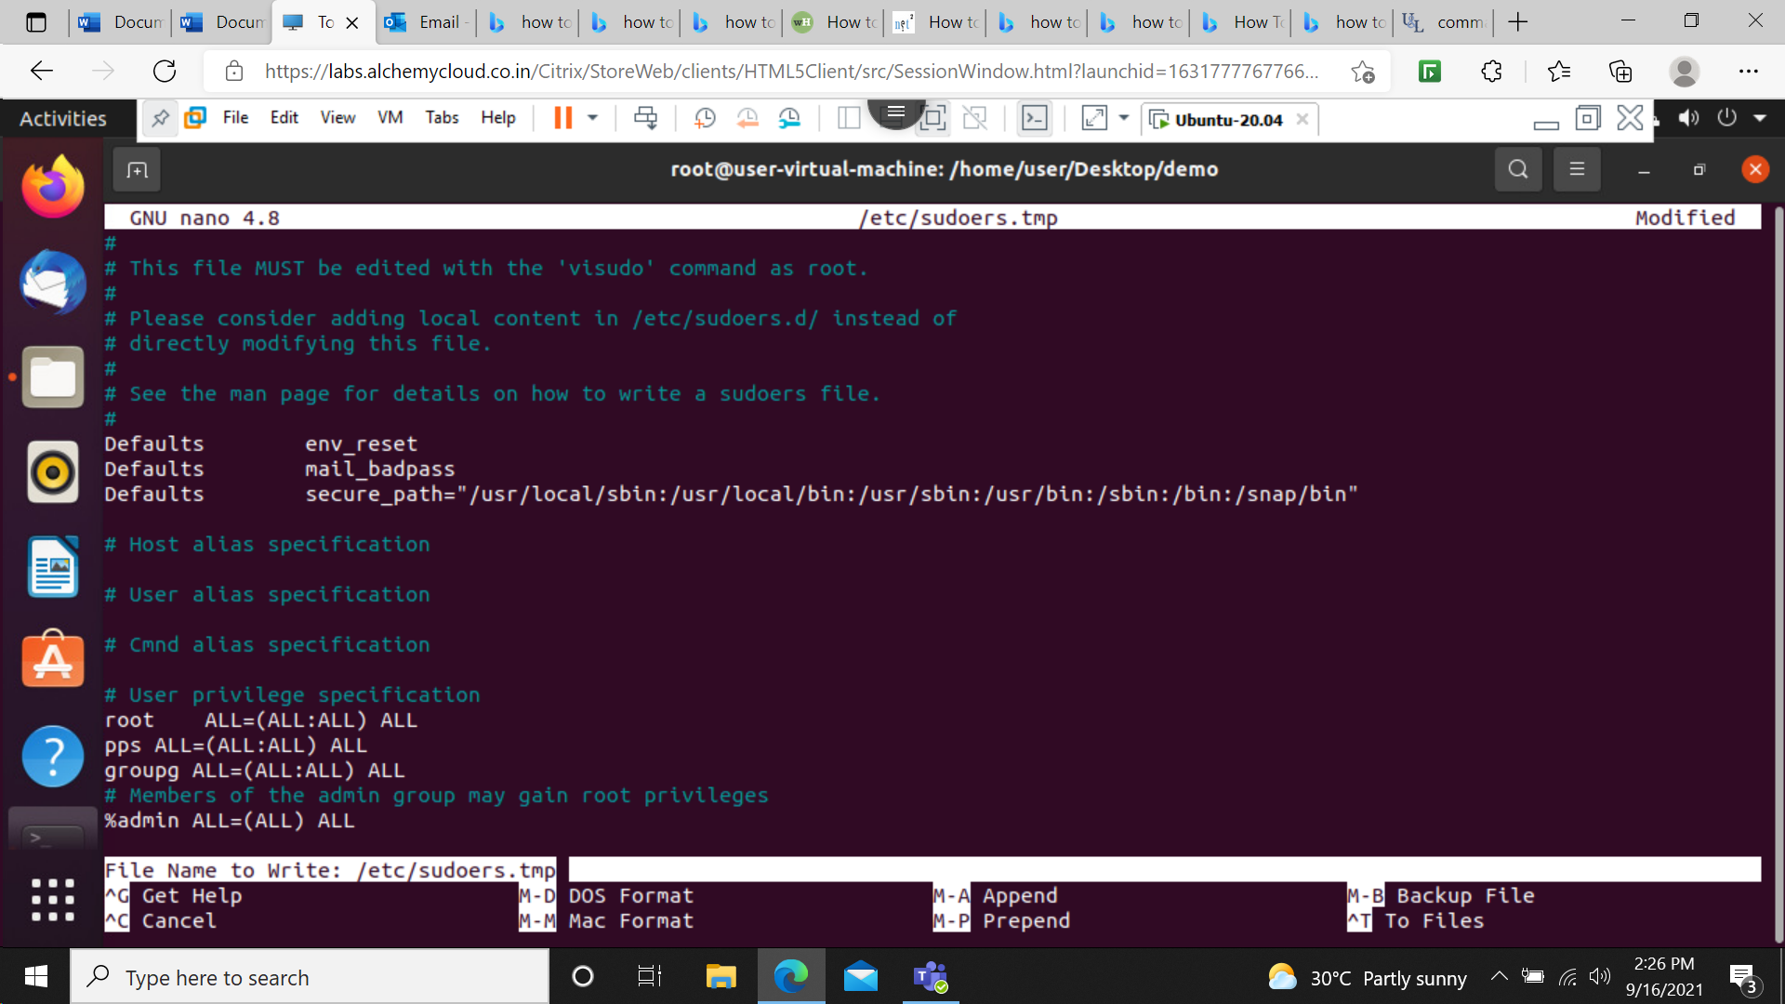
The screen we end up with

Slide 9
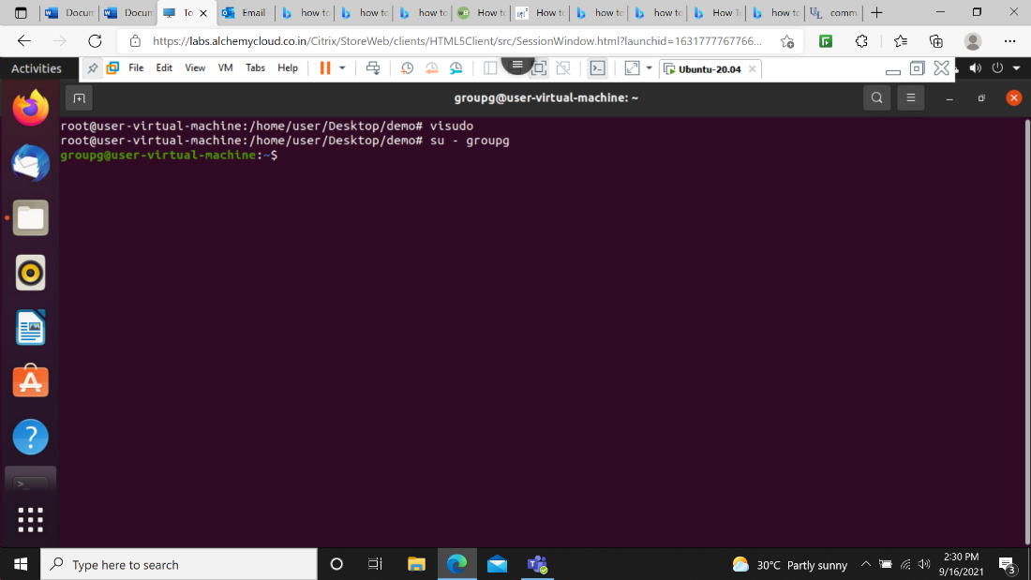
To get back to normal user
Type su groupg

Slide 10
Thank you

